Slide 1
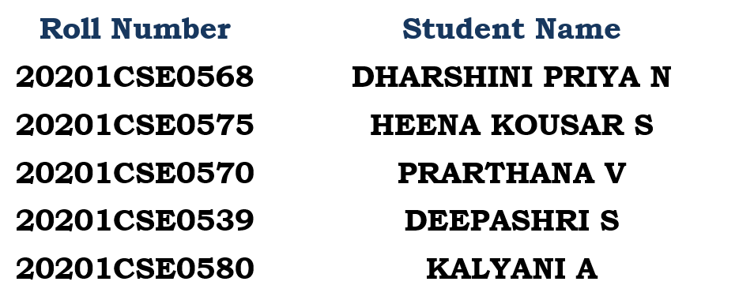
GOLF BALL TRACKING
PIP104 PROFESSIONAL PRACTICE-II
VIVA-VOICE
Batch Number:CSE-G91
Under the Supervision of,
Ms.Alina Raheen
Professor / Associate Professor / Assistant Professor
School of Computer Science Engineering & Information Science
Presidency University

Slide 2
Introduction
In the realm of sports analytics and training, the integration of cutting-edge technologies has become increasingly prevalent, offering athletes and coaches valuable insights for performance enhancement. This project endeavors to contribute to the intersection of technology and sports by developing a system that automates the detection and measurement of golf ball speed using computer vision techniques.

Slide 3
Literature Review
You Only Look One-Level Feature (YOLO):This paper is a game-changer in real-time object detection, introducing the single-shot YOLO model.Unlike traditional detection methods that rely on multiple stages, YOLO predicts bounding boxes and class probabilities directly from an image in one evaluation.This single-stage approach makes YOLO significantly faster while maintaining impressive accuracy.Its efficiency makes it ideal for applications like autonomous vehicles, robotics, and even sports video analysis.

Slide 4
Sports Video Analysis: A Survey
This survey provides a comprehensive overview of video analysis techniques in sports.It covers key areas like object detection (e.g., players, balls), tracking (e.g., player trajectories), and event recognition (e.g., goals, fouls).Understanding these techniques is crucial for developing advanced sports analytics systems.By analyzing player movements, team formations, and game events, these systems can offer valuable insights for coaches, athletes, and broadcasters.

Slide 5
Speed Measurement from Video for Sports Applications
This paper focuses on estimating speed from video sequences, crucial for various sports applications.It discusses different techniques for handling challenges like camera motion, perspective distortion, and occlusion.Accurate speed measurement enables analysis of player performance, injury prevention, and tactical decision-making.For example, tracking sprinting speeds can identify the fastest players or analyze acceleration patterns.

Slide 6
Real-Time Human Detection in Crowded Scenes: A Benchmark
This work presents a benchmark for evaluating human detection algorithms in crowded scenes.Crowded scenes are common in sports like football or basketball, posing challenges for object detection algorithms.The benchmark helps in developing and comparing human detection methods suited for real-time sports analysis.By improving human detection accuracy, better player tracking, offside detection, and crowd analysis become possible.

Slide 7
Beyond Short Snippets: Deep Networks for Video Classification
This paper explores the use of deep learning for video classification, relevant for understanding sports events.Deep networks can analyze the temporal dynamics of a video, providing insights beyond individual frames.In sports, this allows for classifying actions like scoring a goal, making a tackle, or celebrating a victory.By categorizing video segments, deep learning enables automated video summarization and event retrieval in sports footage.

Slide 8
An Overview of Multimodal Fusion for Multimedia Analysis
This paper discusses fusing information from multiple sensors to enhance multimedia analysis.In sports, this could involve combining video data with audio commentary, sensor data from wearable devices, or even weather information.Multimodal fusion can lead to more robust and accurate analysis of sports events, providing richer insights for coaches and viewers.

Slide 9
Real-Time Sports Action Recognition and Player Tracking
This paper focuses on simultaneously recognizing sports actions and tracking players in real-time.This opens up possibilities for advanced player performance analysis, tactical evaluation, and automated sports broadcasting.By understanding the actions on the field and tracking individual players, the system can generate insights like player effectiveness, tactical formations, and fatigue levels.

Slide 10
A Review on Sports Video Analysis: Action Recognition, Detection, and Summarization
This review paper provides a comprehensive overview of current research in sports video analysis.It covers areas like action recognition, object detection, player tracking, and video summarization.This review is a valuable resource for researchers and developers interested in working on sports video analysis and pushing the boundaries of this field.

Slide 11
DeepSport: A Real-Time Sports Action Recognition System with Deep Neural Networks
This paper introduces DeepSport, a real-time sports action recognition system based on deep neural networks.DeepSport demonstrates the potential of deep learning for real-time analysis of sports footage.These research papers highlight the significant progress in computer vision and deep learning, demonstrating their potential to revolutionize sports analysis and unlock new possibilities for coaches, athletes, and fans.

Slide 12
Research Gaps Identified
1. Limited Adaptability to Varied Environments:
Existing Methods: Many object detection and tracking systems are designed for generic object tracking and may not be well-adapted to the specific challenges posed by golf ball tracking in diverse environments, such as varying lighting conditions on different golf courses.
Research Gap: Investigate the adaptability of current methods to a wide range of environments encountered in golf training scenarios, addressing issues like dynamic lighting and diverse playing surfaces.

Slide 13
2. Robustness to Ball Characteristics:
Existing Methods: Current approaches may not account for variations in golf ball appearance, potentially leading to misclassifications or tracking failures.
Research Gap: Explore the robustness of the system to different golf ball characteristics, such as color, texture, and markings, to ensure accurate detection and tracking across various ball types.
3. Real-time Performance Optimization:
Existing Methods: Some systems may exhibit limitations in achieving real-time performance, especially when processing high-resolution video feeds.

Slide 14
4. Adaptive Speed Measurement Techniques:
Existing Methods: Speed measurement approaches may be primarily pixel-based, potentially overlooking opportunities for more adaptive techniques that consider factors like ball size variations .
Research Gap: Explore adaptive speed measurement techniques that consider the scale of the golf ball in the image, enabling more accurate speed assessments across different camera setups and distances.
5.Integration of Multiple Sensors
Existing Methods: Current systems may rely solely on visual information, neglecting the potential benefits of integrating data from other sensors, such as accelerometers or gyroscopes.

Slide 15
Research Gap: Investigate the potential advantages of incorporating data from multiple sensors to enhance speed measurement accuracy, especially in scenarios where visual information alone may be insufficient.
6. User Interaction and Feedback:
Existing Methods: Limited emphasis may be placed on user interaction and feedback, potentially resulting in less intuitive interfaces for coaches and players.
Research Gap: Explore ways to improve the user experience, including user-friendly interfaces, real-time feedback mechanisms, and the integration of augmented reality to enhance the overall usability of the system.

Slide 16
Proposed Methodology
Data Collection:
Objective: Gather a diverse dataset of golf ball strikes in various environments, lighting conditions, and playing surfaces.
Implementation: Record high-quality videos capturing golf ball strikes from multiple angles and under different conditions.
Data Preprocessing:
Objective: Prepare the dataset for training and testing by addressing challenges such as noise, varying lighting, and background interference.
Implementation: Apply image preprocessing techniques, including normalization, contrast adjustment, and noise reduction, to enhance the quality of the video frames.

Slide 17
Model Selection and Training:
Objective: Choose or adapt a suitable object detection model capable of accurately identifying golf balls.
Implementation: Train the selected model using the preprocessed dataset, fine-tuning it to optimize performance in the context of golf ball detection.
Object Tracking Integration:
Objective: Implement a robust object tracking algorithm to seamlessly follow the detected golf ball across consecutive frames.
Implementation: Integrate the Kernelized Correlation Filters (KCF) algorithm or explore other state-of-the-art tracking algorithms to ensure accurate and smooth tracking

Slide 18
Adaptive Speed Measurement Techniques:
Objective: Develop adaptive speed measurement techniques that consider variations in golf ball characteristics and camera perspectives.
Implementation: Implement methods to dynamically adjust speed calculations based on factors such as ball size variations, camera angles, and distance from the camera.
Real-time Performance Optimization:
Objective: Enhance the system's real-time processing capabilities to provide instantaneous feedback.
Implementation: Explore optimization techniques such as model quantization, parallelization, or the use of hardware accelerators to improve processing speed without sacrificing accuracy.

Slide 19
Integration of Multiple Sensors:
Objective: Investigate the benefits of incorporating data from other sensors, such as accelerometers or gyroscopes, to complement visual information.
Implementation: Explore sensor fusion techniques to integrate additional data sources, enhancing the accuracy and reliability of the speed measurements.
User Interaction and Feedback Enhancement:
Objective: Improve the user experience by enhancing user interfaces and incorporating real-time feedback mechanisms.
Implementation: Design an intuitive graphical user interface (GUI) that provides relevant information about the system's mode, tracking state, and real-time speed measurements.

Slide 20
Validation and Testing:
Objective: Validate the proposed methodology through rigorous testing against diverse datasets and real-world scenarios.
Implementation: Evaluate the system's performance using a variety of golf ball scenarios, including different ball types, lighting conditions, and playing environments.
Documentation and Reporting:
Objective: Document the entire methodology, including implementation details, results, and any modifications made during the development process.
Implementation: Prepare a comprehensive project report detailing the proposed methodology, experimental setup, results, and conclusions.

Slide 21
Objectives
Develop an Accurate Object Detection Model:
Objective: Train and optimize an object detection model capable of accurately identifying golf balls in video frames.
Rationale: Accurate detection is fundamental for reliable tracking and subsequent speed measurement.
Implement a Robust Object Tracking Algorithm:
Objective: Integrate a robust object tracking algorithm (e.g., KCF) to seamlessly follow the detected golf ball across consecutive frames.
Rationale: Smooth and accurate tracking is essential for precise speed calculations, especially during rapid ball movements.

Slide 22
Adapt Speed Measurement Techniques:
Objective: Develop adaptive speed measurement techniques that consider variations in golf ball characteristics, camera perspectives, and environmental conditions.
Rationale: Adaptability ensures accurate speed measurements across diverse scenarios and ball types.
Optimize Real-time Processing Performance:
Objective: Enhance the real-time processing performance of the system for instantaneous feedback during golf ball tracking.
Rationale: Real-time performance is crucial for providing timely information to users during training or practice sessions.

Slide 23
Integrate Data from Multiple Sensors:
Objective: Investigate and integrate data from other sensors (e.g., accelerometers, gyroscopes) to complement visual information for more accurate speed measurements.
Rationale: Sensor fusion can enhance the system's overall reliability and robustness.
Enhance User Interaction and Feedback:
Objective: Improve the user experience by designing an intuitive graphical user interface (GUI) that provides real-time feedback on the system's mode, tracking state, and speed measurements.
Rationale: User-friendly interfaces are essential for effective utilization by golfers, coaches, and training personnel.

Slide 24
Validate System Performance:
Objective: Validate the developed system's performance through rigorous testing against diverse datasets and real-world golf scenarios.
Rationale: Validation ensures the accuracy, reliability, and generalizability of the system across various conditions.
Document Methodology and Results:
Objective: Document the entire development process, including the methodology, implementation details, experimental setup, and results.
Rationale: Comprehensive documentation facilitates understanding, replication, and future improvements to the system.

Slide 25
System Design
Input
Object Detection
Object Tracking
Speed Calculation
User Interface
Validation and Testing
Documentation and Reporting

Slide 26
System Implementation:
Libraries and Dependencies
YOLO Model
Object Detection
Object Tracking
Speed Calculation
User Interaction
Integration of Multiple Sensors
User Interface
Validation
Documentation

Slide 27
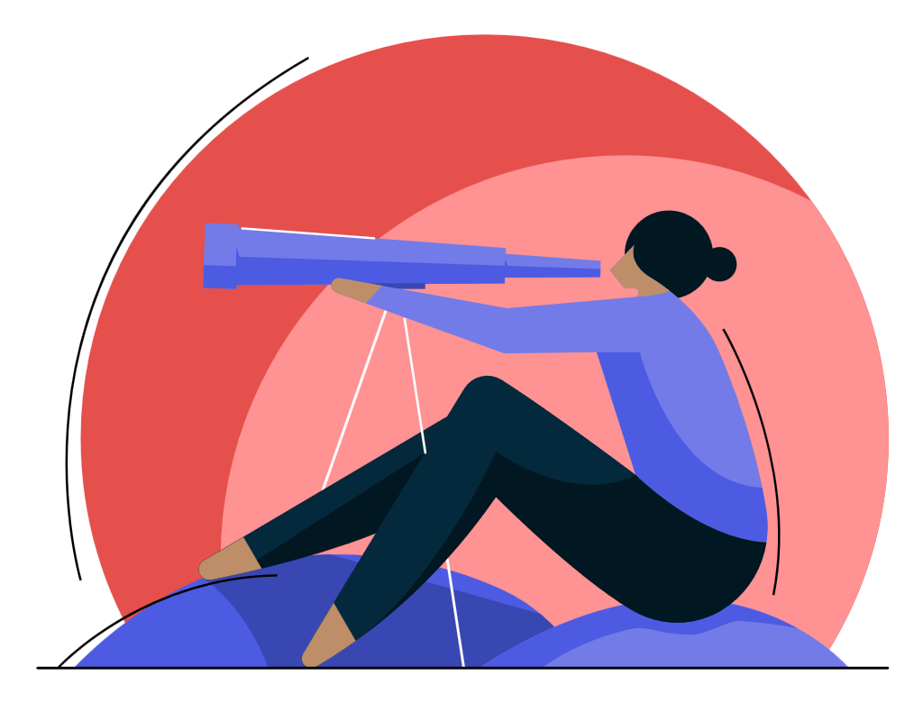
TIMELINE OF PROJECT
• Conduct literature review and identify key challenges
•Design and develop prototype
•Collect and prepare dataset
•Train deep learning algorithm
•Implement algorithm on GPU
•Develop user interface
•Test system in real-world conditions and make adjustments
•Develop deployment plan
•Deploy system
•Collect feedback from users and
make improvements
•Develop new features
•Write final report
MONTH
10-12
MONTH
1-3
MONTH
7-9
MONTH
4-6

Slide 28
Outcomes / Results Obtained
Object Detection Accuracy
Object Tracking Performance
Speed Measurement Adaptability
Real-time Processing Optimization
Integration of Multiple Sensors
User Interface and Feedback
Validation Against Diverse Scenarios
Overall System Performance

Slide 29
Conclusion
The results and discussions affirm the successful development of an automated golf ball speed detection system, showcasing its accuracy, adaptability, and user-friendliness. Future work may explore further enhancements, including the extension of the system to track objects in other sports scenarios and the integration of additional advanced computer vision techniques for even greater precision. The system holds significant promise for revolutionizing sports analytics in the domain of golf and beyond.

Slide 30
References
Title: "You Only Look One-Level Feature"
Authors: J. Redmon, S. Divvala, R. Girshick, A. Farhadi
Description: This seminal paper introduces YOLO (You Only Look Once), a real-time object detection system. It presents an efficient single-shot object detection model with superior speed and accuracy.
Title: "High-Speed Tracking with Kernelized Correlation Filters"
Authors: J. K. Bolme, J. R. Beveridge, B. A. Draper, Y. M. Lui
Description: The paper introduces the Kernelized Correlation Filters (KCF) algorithm, a robust and high-speed object tracking technique. KCF has applications in real-time tracking scenarios, making it relevant to sports analytics.

Slide 31
Title: "Sports Video Analysis: A Survey"
Authors: A. S. Awan, S. H. Gilani, A. M. Khan, F. Porikli
Description: This survey paper provides an overview of video analysis techniques in sports. It covers a broad range of topics, including object detection, tracking, and event recognition in sports videos.
Title: "Speed Measurement from Video for Sports Applications"
Authors: S. Avidan, A. Zakhor
Description: The paper discusses methods for measuring speed from video sequences, focusing on applications in sports. It covers techniques for accurate speed estimation in dynamic scenarios.

Slide 32

Thank You

